Slide 1


Introduction to version control with git and GitHub

Slide 2

What is git?
Program for version control on local computer
Create repository with all files

Slide 3
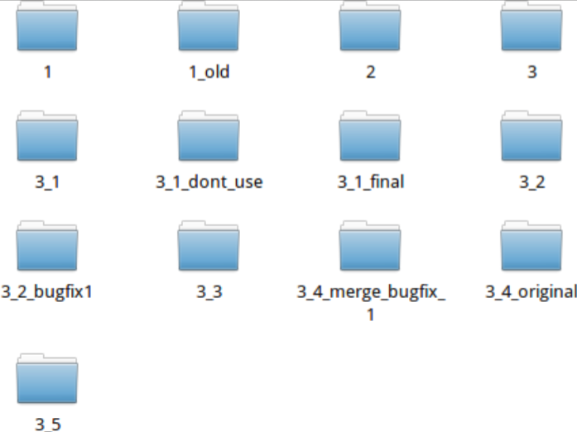
Why git?
Because this can become very complicated
Free
Emphasis on speed and data integrity

Slide 4


What is GitHub?
GitHub
Internet hosting service for git repositories
Follow other programmers
Work on multiple computers (connected to the internet)

Slide 5
Why GitHub?
GitHub
Free
Promotes collaboration
Most used
Work from any computer connected to the internet

Slide 6
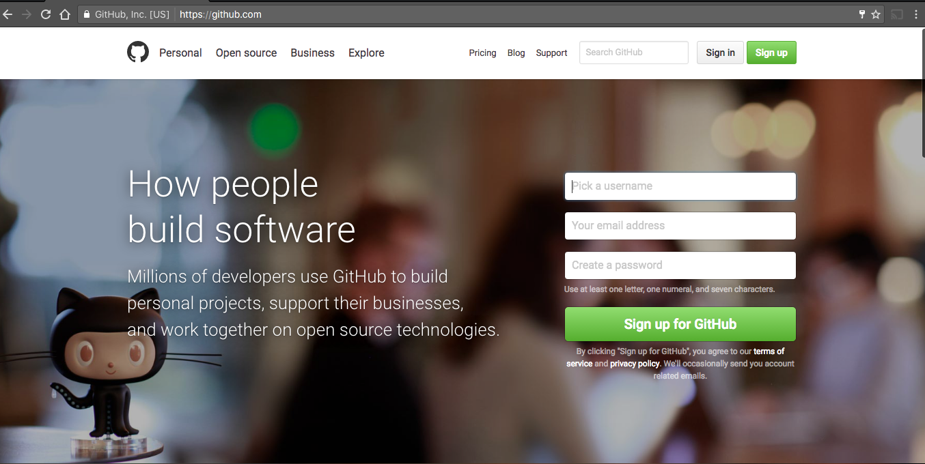
Create an account

Slide 7
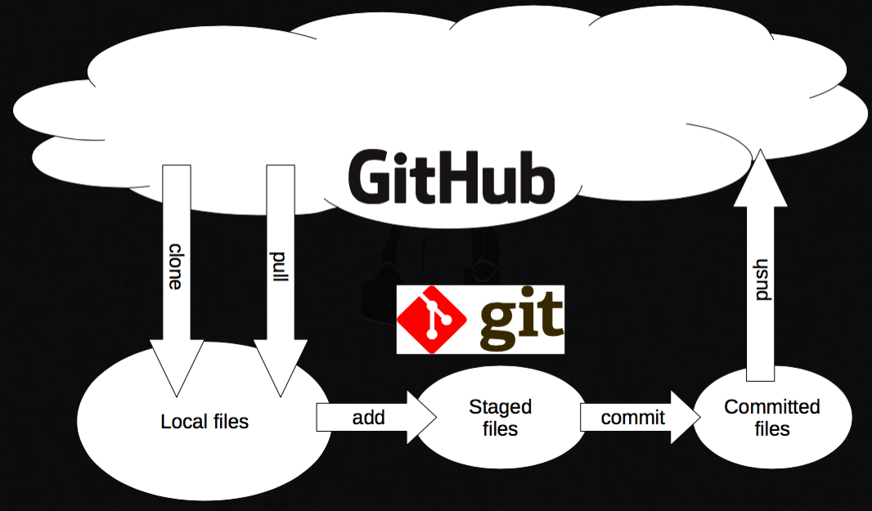
How to work with git and GitHub?

Slide 8

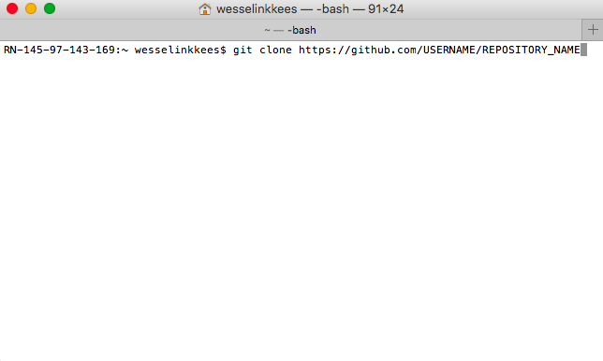
How to work with git and GitHub?
git clone https://github.com/USERNAME/REPOSITORY_NAME
Clone repository from github to local computer
git pull
Pull the repository from github to local computer

Slide 9
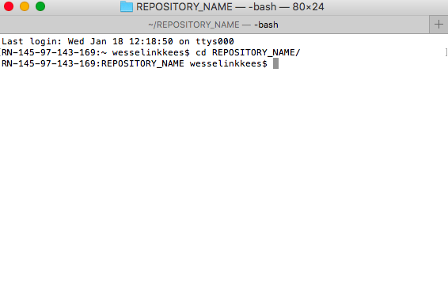
How to work with git and GitHub?
cd REPOSITORY_NAME
Go to folder
git add –all :/
Add every change to stage
git commit –m “MESSAGE”
Commit staged files with a commit message

Slide 10
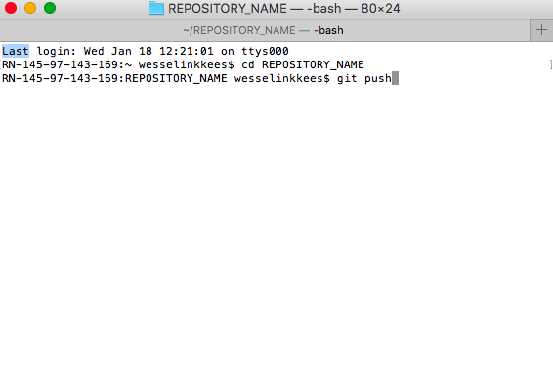
How to work with git and GitHub?
git push
Push all committed files back to GitHub

Slide 11
How to work with git and GitHub?

Slide 12
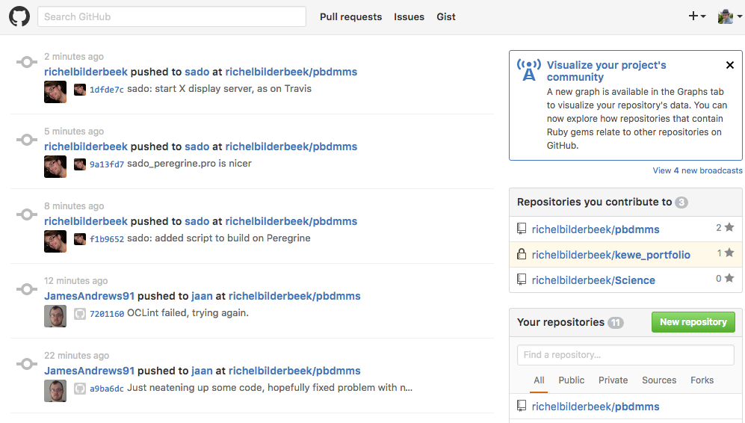
Create a repository

Slide 13
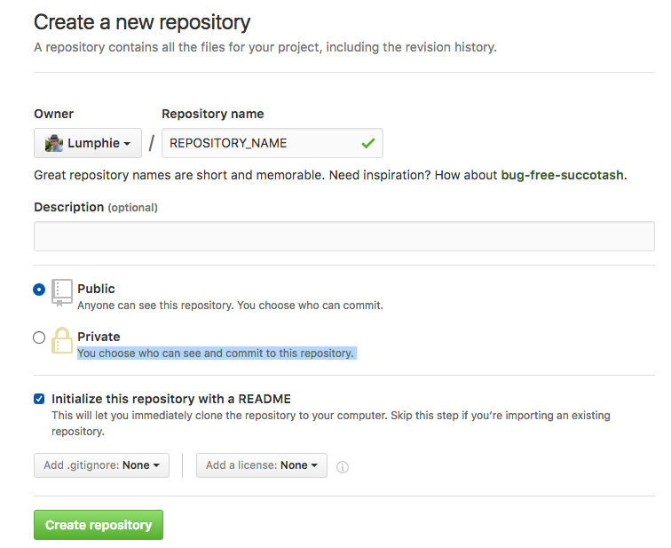
Create a repository

Slide 14
Commands
git clone https://github.com/USERNAME/REPOSITORY_NAME
git add --all :/
git commit -m “MESSAGE”
git push
git pull
cd FOLDER_NAME (go to folder) & cd .. (go back)
git status (to see edited files)

Slide 15
Forking, Branching and Merging
Forking
Make a copy of a repository
Pull request can be rejected
Branching
Only when collaborating
Pull request cannot be rejected
git checkout BRANCHNAME (to switch branches)

Slide 16
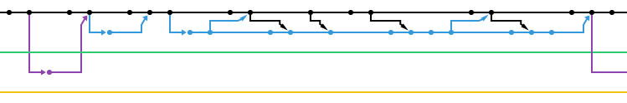
Forking, Branching and Merging
Merging
Brings a branch back to the master build

Slide 17
Merge conflicts
Master
Branch A
Repository with multiple branches
Branch B
MERGE CONFLICT
Master
Master
Master

Slide 18
Merge conflicts
<<<<<<< HEAD
MASTER VERSION OF YOUR FILE
=======
BRANCH VERSION OF YOUR FILE
>>>>>>> branch_name
Manually delete the version that you don’t want (also delete
<<<<<<< HEAD
=======
>>>>>>> branch_name)
Then add, commit and push again

Slide 19
Exercise - working in a team
Write a fairy tale with the whole group
Working on the same repository
Make your own branch
Merge conflicts will happen A LOT
Fix merge conflicts
End time 12:30

